Slide 1
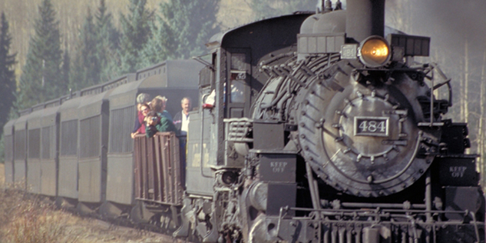
THERMODYNAMICS

Slide 2
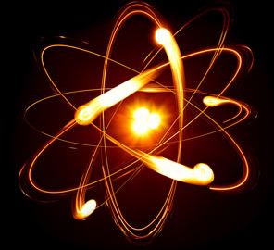
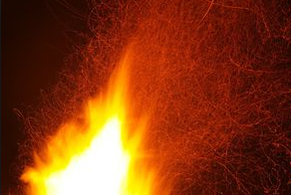

Slide 3
THE SYSTEM AND SURROUNDING

Slide 4
THE SYSTEM AND SURROUNDINGS

Slide 5
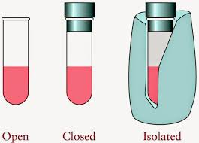
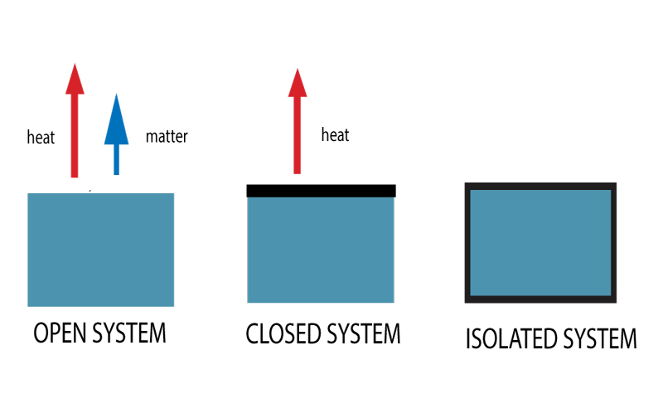
TYPES OF SYSTEM

Slide 6
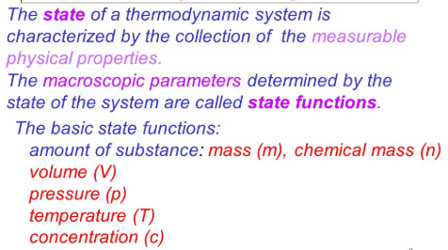
STATE OF SYSTEM

Slide 8
Example 2: Pressure inside the inflated balloon. Pressure is a state function it does not depends on the path by which it is attained through mouth or by a pressure pump.

Slide 9
Internal energy (U) of the system depends on:
heat passes in or out
Work done on or by
Matter enter of leave

